Slide 1


The gravitational wave signal from binary super-massive black holes does not form an isotropic background
Vikram Ravi
The University of Melbourne, CSIRO etc.
With Stuart Wyithe, George, Ryan

Slide 2
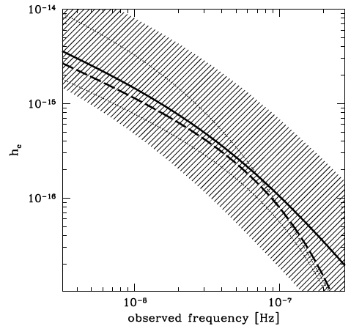
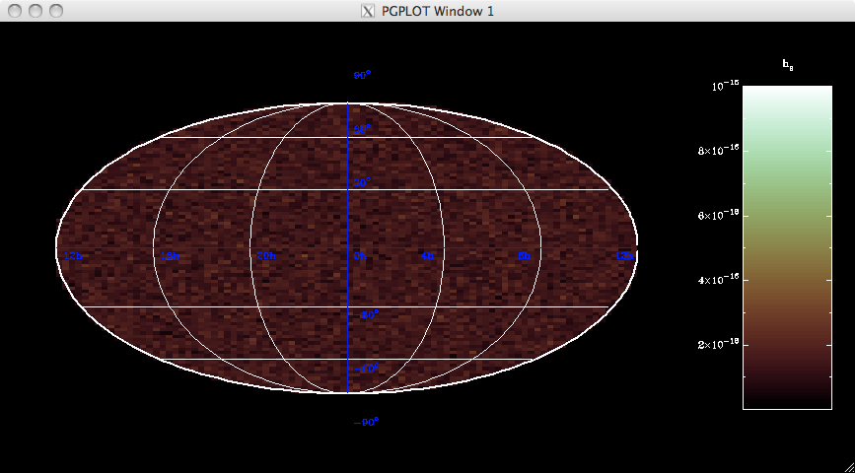
From signal models to detection
Alberto’s head
Mean characteristic strain spectrum of GW signal from binaries
Assume this signal induces random Gaussian TOA perturbations
GW detector, estimator

Slide 3
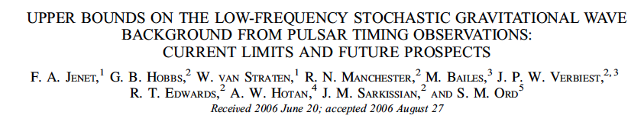
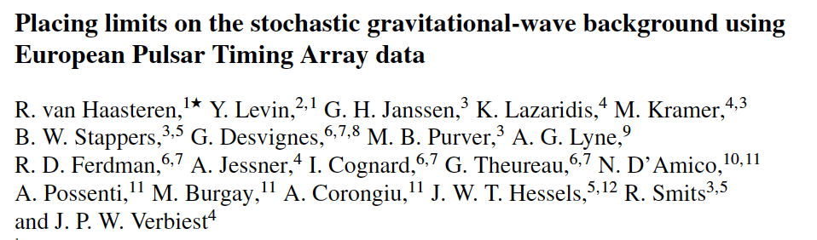
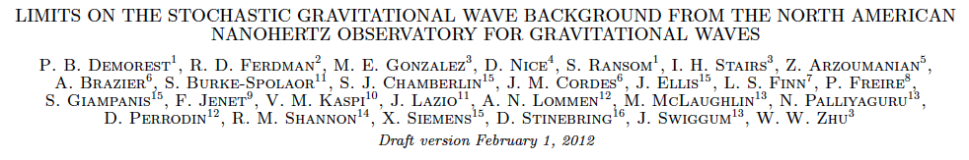
What are the shortcomings?
We don’t know that the GW signal from binary super-massive black holes (SMBHs) results in random Gaussian TOA perturbations.
Are current GW detection/estimation strategies optimal for binary SMBHs?
Can we really compare existing limits on a GWB to model predictions for the mean signal amplitude?
Some definitions:
Random Gaussian process: Realisations at every point are normally distributed. Realisations at different points can be covariant with each other.
The GW background is assumed to be…
Stochastic: not deterministic! (sure)
Isotropic: looks the same in every direction. (really?)

Slide 4
What we did
Simulate the population of binary SMBHs
We didn’t include any radically new binary evolution physics – this is really basic stuff assuming heaps of things!
Use these simulations to generate realisations of the induced TOA perturbations for a single pulsar
We included perturbations caused by every significant binary
These form true pre-fit residuals
Compare these realisations with realisations including a signal of the same amplitude modelled as a Gaussian process.
We did our analysis in the Fourier domain, naturally.
Power spectral density of TOA perturbations R(t) (FT = Fourier Transform):

Slide 5
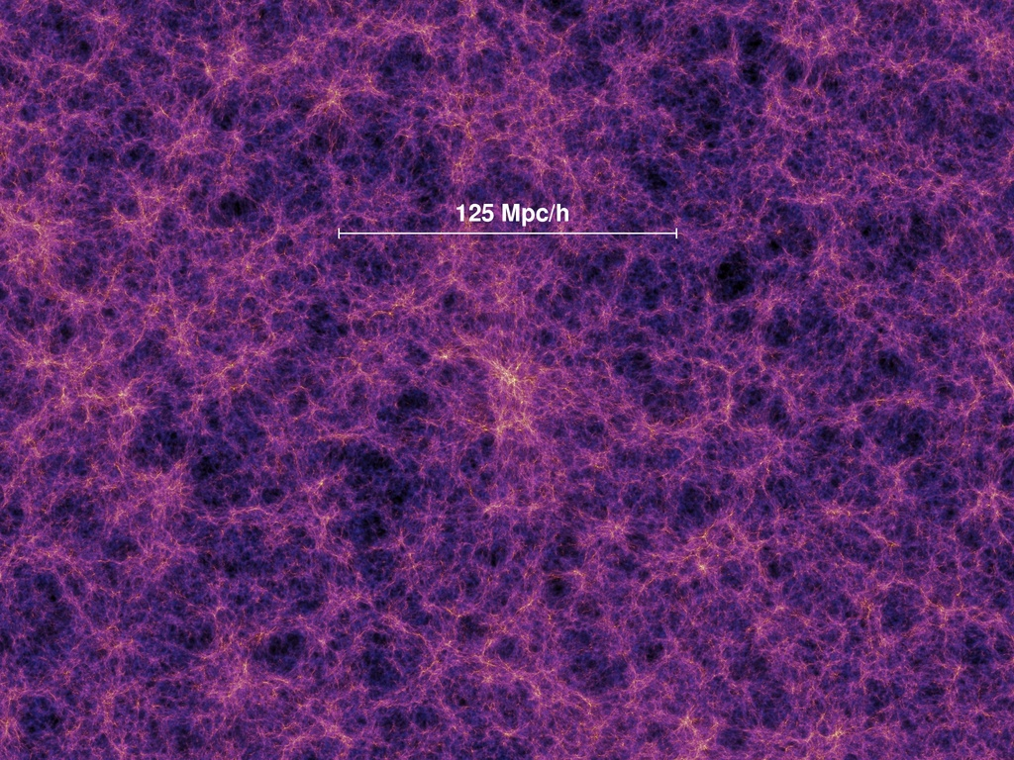
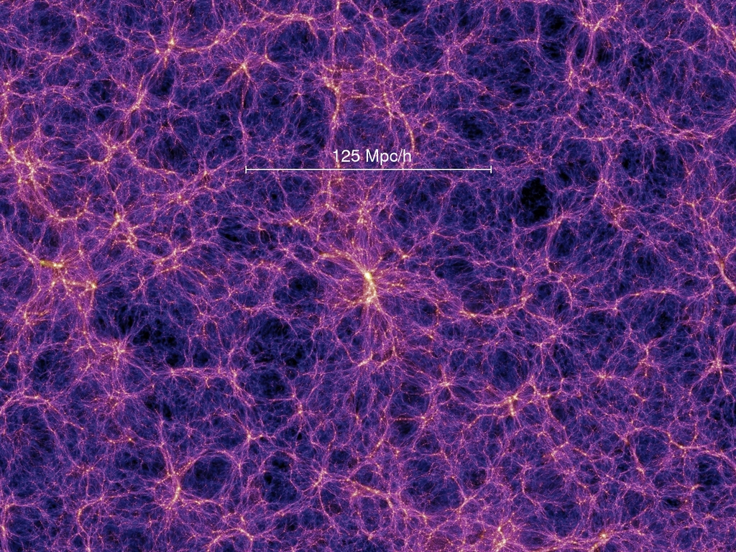
Predicting the distribution of SMBHs – Guo et al. (2011) model
Based on previous MPA models (e.g., Springel et al. 2005; Croton et al. 2006; De Lucia & Blaizot 2007)
Uses the Millennium (Springel et al. 2005) and Millennium-II (Boylan-Kolchin et al. 2009) simulations for dark matter halo merger trees.
Millennium: 685 Mpc a side; Millennium-II: 137 Mpc a side. Both traced 2160³ particles from z=127 to z=0.
Observations used to tune the model
Successful predictions – heaps!
z=0 stellar mass function
Local M_{BH}-M_{Bulge} relation.
Galaxy luminosity functions
SFR history (until z=2)
Matches SDSS galaxy abundance and clustering properties
Tully-Fisher relation
Cluster properties
BH scaling relations
z<2 AGN luminosity function
AGN clustering
…

Slide 6
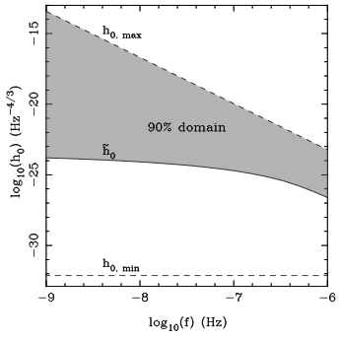
Converting lists of SMBH coalescences to residuals
Form the distribution of the observable number, N, of binary SMBHs per unit h₀, per unit f:
From G11
From cosmology
From GR
h₀ is the frequency-independent strain squared for a binary
Fit the distribution with an analytic function
Draw sources corresponding on average to 90% of the expected mean induced timing residual PSD
Simulate the remaining power using TEMPO2

Slide 7
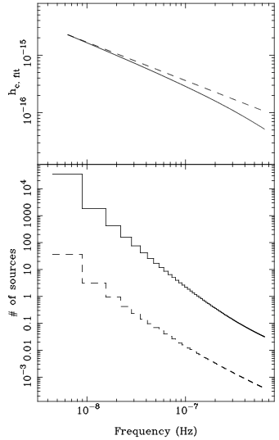
A curve with spectral index -2/3
A few sources appear to dominate!
1/(1 year)
The mean predicted characteristic strain spectrum (curvature caused by last stable orbit prescription)
Mean number of sources contributing 90% of the induced timing residual PSD
Mean number of sources contributing 50% of the induced timing residual PSD

Slide 8
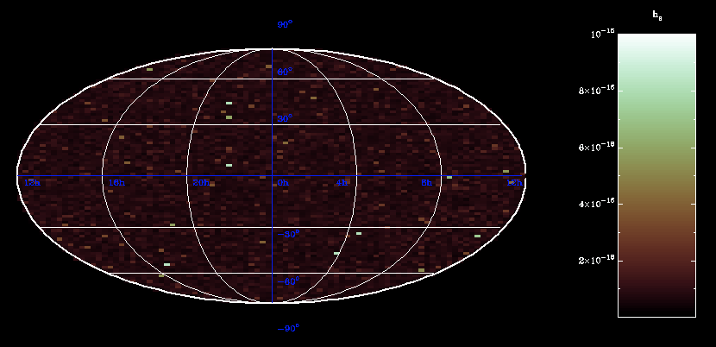
Comparison with TEMPO2
Single realisation of 200,000 sources corresponding to the TEMPO2 signal
GW strain
Single realisation of ~500,000 sources from our model
GW strain

Slide 9
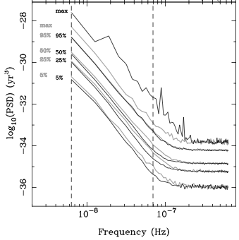
Comparing PSDs of TOA perturbations
Simulate datasets with:
5 years, 500 regular samples, 1ns Gaussian white noise
Add GW-induced timing residuals from out model
Add GW-induced timing residuals from (hacked) TEMPO2 GWbkgrd corresponding to the predicted strain spectrum.
Compare Cholesky PSDs
So, the TOA perturbations induced by GWs from binary SMBHs do not represent a random Gaussian process.
Open questions:
How model-dependent is this?
What is the effect of this on GWB parameter estimation?
“Percentile PSDs”
Thin black: our model
Thick grey: GWbkgrd

Slide 10
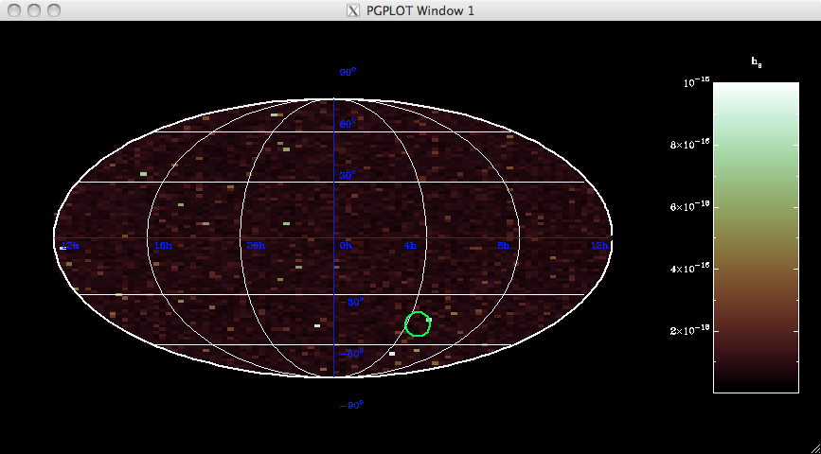
A realisation of the GW sky

Slide 11
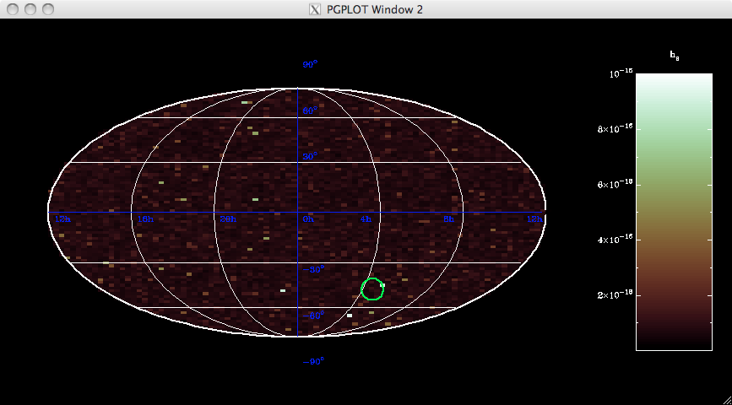
Now take out the sources producing the highest-amplitude TOA perturbations in the lowest 20 spectral bins

Slide 12

And do the same again

Slide 13
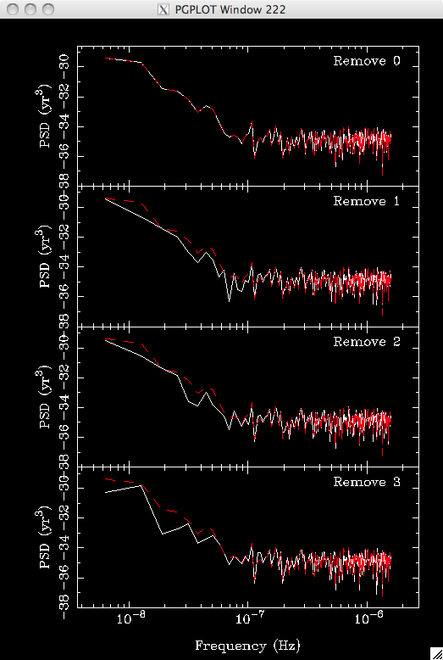
Power spectral densities of simulated timing residuals before and after removing the highest-perturbation-amplitude sources in the lowest 20 frequency bins
These are complicated!
But the effect is clear – individual sources dominate some spectral bins!
We predict: one single source above the mean total GW-induced timing residual PSD in one of the lowest 10 spectral bins of a 5-year dataset.

Slide 14
Conclusions
There are clear differences between GW-induced TOA perturbations from the predicted binary SMBH distribution, and perturbations modelled as a random Gaussian process.
These differences are caused by a few sources contributing most of the GW-induced TOA perturbation PSD in every frequency bin of a 5-year dataset.
Current techniques used to estimate the GWB amplitude are therefore not completely consistent with the GW signal from binary SMBHs.
Given that a few sources appear to dominate the GW-induced TOA perturbations, limit/detection methods that account for this will be more optimal than existing ones.

Slide 15
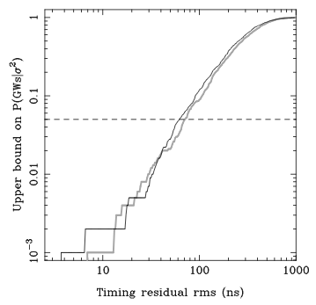
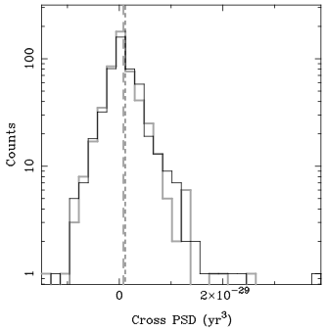
Does this affect existing limits?
Estimate of P(GWs|rms) for different measured timing residual rms values, using the lowest spectral bin
Distributions of GW-induced correlations between a pair of pulsars in the lowest spectral bin
This work
0.05
This work
Gaussian model
Gaussian model

Slide 16
Does this affect existing limits? Not too much…
Existing limits use likelihoods of data/data-statistic given GWs. We predict different likelihoods from the TEMPO2 model. So yes!
But our estimate is that the effect is marginal. For example, a 95% ruling out of a TEMPO2-simulated signal with our predicted strain spectrum actually rules out the signal with 92% confidence.
The distributions of the correlation between pulsars are also only slightly different. (but both are still very wide…)

